Slide 1
5G Era
Storage Solution
Ken Chilton
Vice President, CTO
Huawei Storage and Data Management

Slide 2
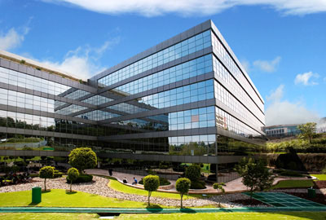
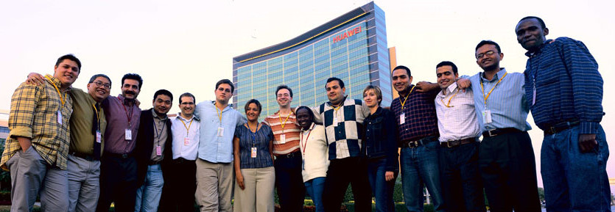

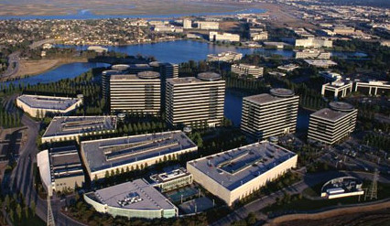
15 Years of Effort to Make Huawei Storage Grow
18+ Years
Acquired Huawei-Symantec
in 2012
30+
Industry Organization Members
4000+
R&D Engineers
`
1600+
Storage Patents
12
R&D Centers
Notes:
历经15年，华为存储蓬勃发展，成为华为ICT战略的重要组成

Slide 3

Storage Leadership
No.1 Market Share in China and No.1 Growth Rate in Global Market
ECB Storage Shipment Capacity
in the China Market
AFA Market Share Growth Rate
in the Global Market
3
Huawei Confidential
Notes:
市场份额中国第一，全球增速第一

Slide 4




We Are Entering the 5G Era, An Era of Explosive Data Growth
64 TB/day
Training data
TB level
Traditional data
PB level
Videos & images
5G
AI
Cloud computing
Autonomous driving
Enterprise IT
Diverse applications
Real-time processing
1 PB/day
Production data
2 Mn
Cameras
80 PB/day
Data volume
30 days
Retention period
Massive data
Digital connected factory
Shenzhen
< 2%
data stored
< 10%
data utilized
Notes:
进入5G时代，新联接、新应用正加速数据生产和流动，带来巨大机遇与挑战
5G era - Explosive data growth
64 TB/day in training data -- autonomous driving
1PB/day in data from digital-connected factories
Smart cities, 2M cameras, 80PB/day
Enterprise IT from TBs to PBs
<2% stored, <10% utilized, losing the value of data

Slide 5
Industry Scenarios Can Be Classified Into Three Major Types
Production Transaction
Big Data and Video
Edge Data
20%
12months vs 3months
20,000 Toll Stations
The total data volume in the account system increases by 20%
The data retention period is expected to change from 3 months to 1 year in telco.
Open road tolling and intelligent toll collection
100,000
1.3Mn vs 5,000
400+ Coal Mines
Peak TPS surges from 20,000 to 100,000 during the Double 11 shopping festival
Huawei's IT system has 1.3 million tables. However, only 5,000 tables can be consumed.
Located in Shanxi province, requiring safe production
Notes:
Production: performance, unexpected surges, mission critical availability
Big Data and Video: data volume is growing faster than technology and application development. Meanwhile, the requirements to retain data are increasing as well.
Edge: New applications every day. IDC has indicated that in 2025, 75% of data will be generated at the edge.

Slide 6



A Converged, Intelligent, Open Data Infrastructure To Unleash Data Value
Industry applications
Government
Carrier
Finance
Public security
Enterprise
Data enabling
Data Integration | Data Management | Data Analysis | Data Service
Data Infrastructure
Open
Data virtualization engine
Full-lifecycle data management system
One
directory
One
interface
One
copy of data
Unified security
Intelligent
eService
Data processing
Data Management Engine
Database
Big data
Converged
Planning
Deployment
O&M
Optimization
Production
Analysis
Backup
Archiving
DeviceManager
Data storage
Intelligent awareness
AI inference
Notes:
“one storage, one lake” architecture to redefine the data infrastructure.
Converged: One copy of the data. Provisioned according to business SLA and automatically allocated resources based on demands. In this way average resource utilization rate can increase from less than 40% to 70%, saving more than 30% TCO.
Intelligent: Through Automation Life Cycle management, intelligent data management system, planning, allocating, maintaining and optimizing of storage resource are fully automated, improving management efficiency by 5 times.
Open: By using open data engine we can realize one directory, one interface, and one piece of data to largely simplify the big data architecture. Data integration efficiency is greatly improved. 80% of analysis time for business launching can be saved.
Key components of Huawei’s one storage one lake solution: Dorado, Distributed, FusionCube, DMS intelligent data management

Slide 7
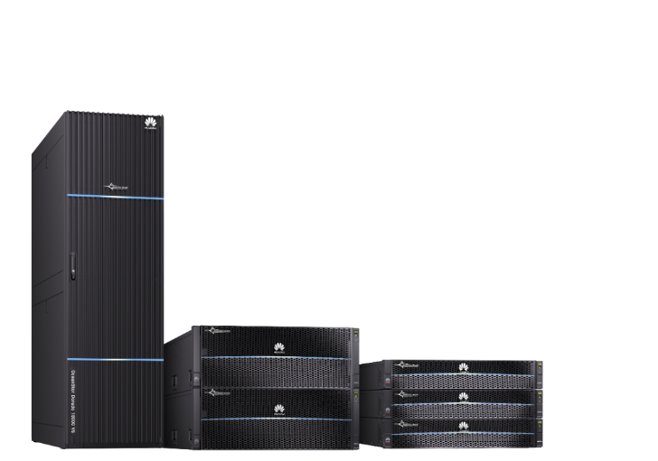





OceanStor Dorado V6 All-Flash: New Series of All-Flash Storage
No.1
20,000,000
IOPS
Tolerance 7 Out of 8
10,001,522
2,401,171
NetApp
AFF A800
Fujitsu
DX8900 S4
Huawei OceanStor
Dorado18000 V6
Source: SPC-1
Notes:
5G era, the amount of carriers’ billing will increase from 120 million to 750 million per million users. The billing frequency will therefore increase by 6.5 times, which requires faster storage to respond.
In addition, the billing service system requires 24/7 operation, thus an ultimate guarantee of storage reliability is needed.
20 million IOPS with 0.1ms latency
FlashLink performance acceleration technology using our self-developed CPUs, AI chips and SSD chips
failure tolerance of 7 out of 8 controllers.
billing time from 10 hours to 3 hours, achieving a 70% reduction

Slide 8
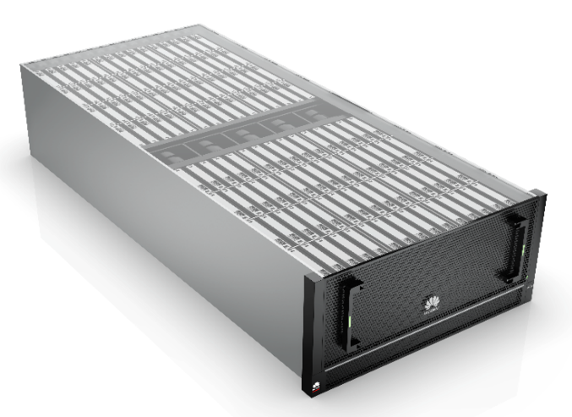
OceanStor Distributed Storage: New Horizon of Capacity for Big Data
62.5% Space Saving
2.7x Disk Utilization
24Disks/U
92%
20Disks/U
67%
9Disks/U
33%
General Purpose
Server
EMC Isilon
H5600
Huawei OceanStor
Pacific Node
Ceph
Hadoop EC
Huawei
Elactic EC
Pacific Capacity Node
2.4PB Raw Capacity
Notes:
In 2020, Huawei will launch a new OceanStor distributed storage with Pacific high-density node. Its ultra-high density can store 120 disks in a 5U space.
Unique butterfly wing design enables the disk enclosure to be withdrawn from both the front side and the back side, which greatly increases the capacity of insertable disks
Together with large-capacity disks, we could double the raw disk capacity.
EC technology achieves the industry's highest data utilization rate, 91%.
Huawei's unique AI Fabric technology is the first to embed AI chips in the switch. The iLossless intelligent lossless exchange algorithm achieves true 0 packet loss network and microsecond-level end-to-end latency which completely breaks the bottleneck when massive data are exchanging between vast distributed storage nodes. This further helps improve the performance by over 15%.
Huawei's intelligent cooling technology achieves idle disk hibernation and intelligent fan speed regulation, which could reduce overall energy consumption by 50%;

Slide 9
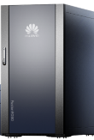
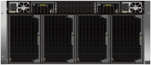
FusionCube Enables a New Market Driven by Edge Data
No.1
Hazardous chemicals
Coal mine
5 in 1 full-stack integration
Free-flow transportation
Emergency response
Power line inspection
Train-to-ground
data dump
Transport
Electricity
5:1
Substation monitoring
FusionCube
Computing
Campus
Smart campus
Storage
Smart grain depot
Government
Network
…
Security
5U
Lottery
Security monitoring
AI
…
24U
Notes:
3
Since 75% of data will originate from the edge, Huawei has created solutions specifically to address edge requirements
Many scenarios: IoT, Smart City/campus, ROBO, MFG, Mine safety, Healthcare, Transportation, carriers
Provides all the needs at the edge, including compute based on Kunpeng ARM CPU and Huawei's AI engine, Storage, Network, Firewall
Available in a non-DC environment capable tower appliance or 5U rack mount unit.
Unified Management

Slide 10






DME Enables Automatic Management
Service Definition
Application template
Planning
Intelligent production
and transaction
Intelligent
data lake
Intelligent
edge
Remote deployment
Automatic provisioning
Deployment
Risk prediction
Fault rectification
Operation&
Maintenance
Performance optimization
Resource Recycling
Automation
Policy
Analysis
Prediction
DME (Data Management Engine)
Initial
investment
Deployment
efficiency
Fault
rectification
Resource
utilization
Optimization
20%
10x
60%
80%
Notes:
DMS concentrates on reducing OpEx by using AI to automate storage management
Already seen eService and in-system AI behind Device Manager
Now, DME automates tasks to reduce Planning, Deployment, O&M, and Optimizes storage assets to ensure maximum value
20% reduction in initial investment
10x deployment efficiency
60% improvement in fault rectification
80% improvement in resource utilization

Slide 11
Case #1: Achieving Fast and Stable Service for Core Banking
Core Banking
Accounting
Product
Pay
Channel
Number of users
Service pressure
2X
93%
Credit line management system
Global payment system
Branch accounting system
Performance improvement
65%
Hosting product system
Real-time quotation system
Data exchange platform
7 x 24
CPU usage
Integrated service platform
Account adjustment system
Channel integration platform
15%
Service continuity
The CPU usage decreases from 93% to 15%,
and services are not interrupted during peak hours.
1010101010101010101010101
Notes:
Dorado case
Case 1: Carrying the bank Core Banking, fearless peak pressure, core trading will never be stable

Slide 12


Case #2: Storage and Computing Separation Improves Resource Utilization and Reduces TCO for Big Data
The customer's TCO is reduced by 40%, and Huawei's sales gross profit increases by 10% to 56%.
TCO Reduction
Available capacity of a single cabinet:
1.5 PB → 3.7 PB
140%
...
Server
Server
Distributed storage
Number of cabinets:
15 → 8
46%
Notes:
Case 2: Big Data Saving separation, improve customer resource utilization efficiency, reduce TCO
Compared to traditional storage, the new OceanStor only uses 8 cabinets instead of 15, reducing the customer TCO by about 40% just in storage improvements alone.

Slide 13
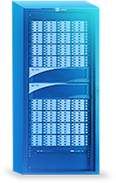

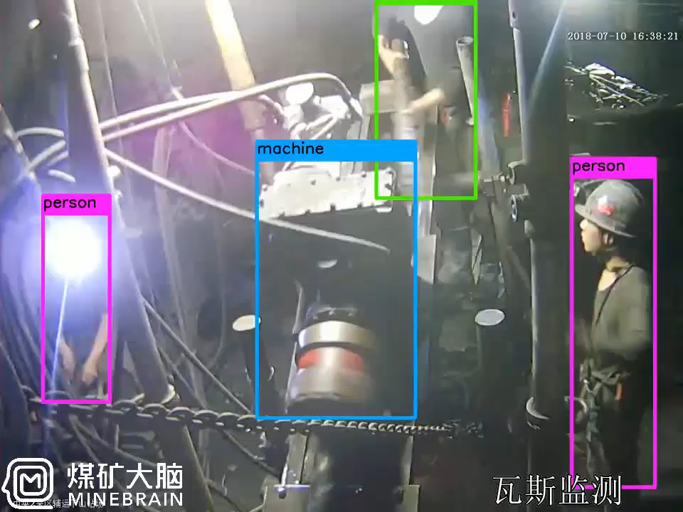












Case #3: Safe Production for Coal Mines
Mine 1
Mine N
Mine M
Inoue
Inoue
Inoue
downhole
downhole
downhole
Mine depth 1km
The roadway 20 km
200+ cameras
2000+ sensors
Notes:
Edge
Case no. 3:
Coal Mine Safety
1km deep
The roadway is 20 km long
200-plus cameras
2000 plus sensors

Slide 14









Openness, Cooperation, Shared Success for Data Infrastructure
A win-win industry
Co-construction of platforms
Business cooperation
Scenario-based innovation
with partners
Technology openness
Technical interoperability & authentication,
cloud platform interconnection
UHD Industry Alliance
Intelligent Data Industry Alliance
Notes:
开放、合作、共赢，共建数据基础设施
Open, cooperative, win-win, and build a data infrastructure

